Slide 1
Computer Vision
General Applications of AI
Focus on Healthcare and Surveillance

Slide 2
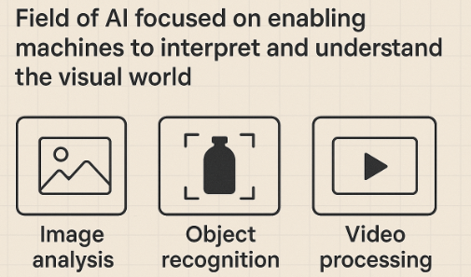
Computer Vision
What is Computer Vision?
Computer Vision = enabling machines to see, interpret, and understand images and videos.
Mimics human visual perception using algorithms and models.
Common tasks:
Image classification
Object detection
Face recognition
Image segmentation

Slide 3
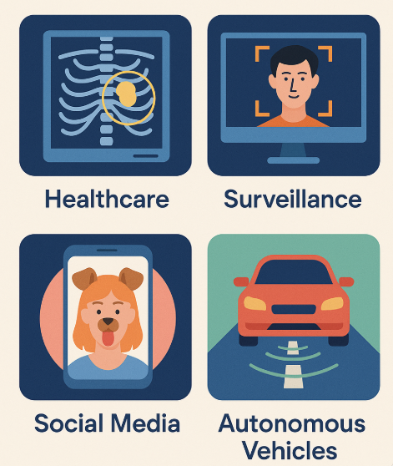
Role of AI in Computer Vision
Real-World Examples
Healthcare: Detecting tumours from X-rays and MRIs
Surveillance: Identifying people in CCTV footage
Social Media: Snapchat filters, Instagram effects
Autonomous Vehicles: Lane detection and obstacle avoidance

Slide 4
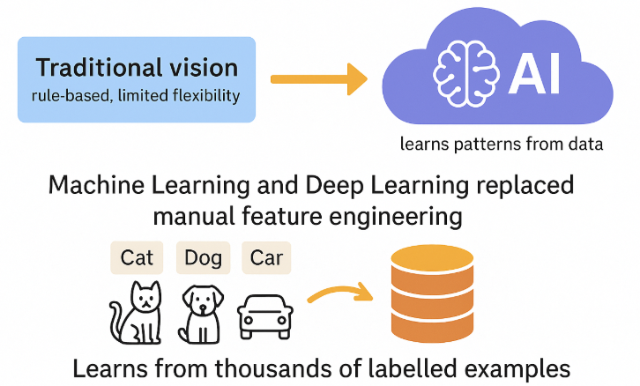
Role of AI in Computer Vision
Role of AI in Computer Vision
Traditional vision → rule-based, limited flexibility
AI → learns patterns from data
Machine Learning and Deep Learning replaced manual feature engineering
Learns from thousands of labeled examples

Slide 5
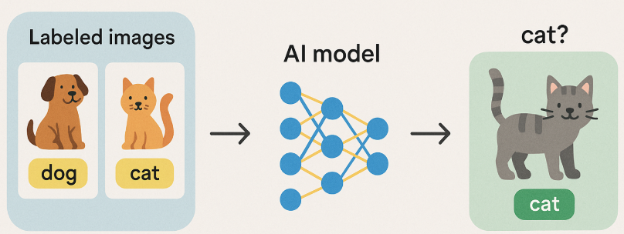
How AI Works in Vision
How AI Works in Vision
AI model is trained on labeled images (e.g., dog, cat)
Learns to generalize and classify new unseen images
Improves with more data and better models

Slide 6
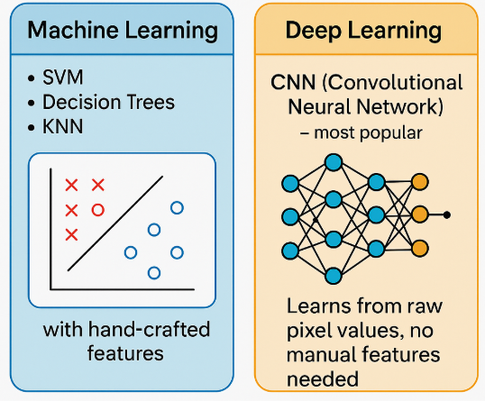
Key AI Models in Computer Vision
Key AI Models in Computer Vision
Machine Learning:
SVM, Decision Trees, KNN (with hand-crafted features)
Deep Learning:
CNN (Convolutional Neural Network) – most popular
Learns from raw pixel values, no manual features needed

Slide 7
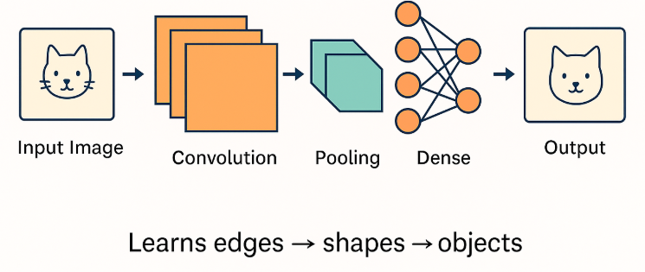
CNN Architecture
CNN Architecture (Simplified)
Learns edges → shapes → objects

Slide 8
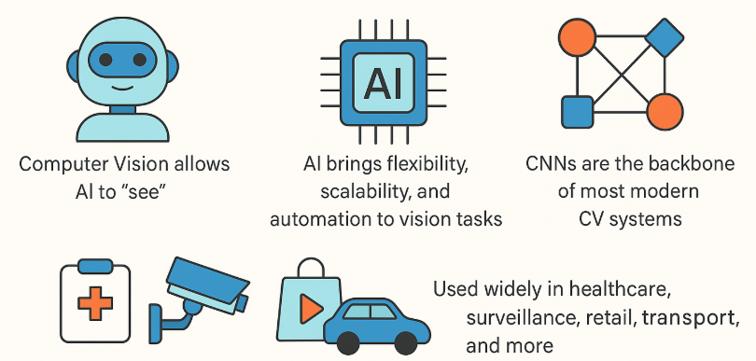
Summarizing…………

Slide 9
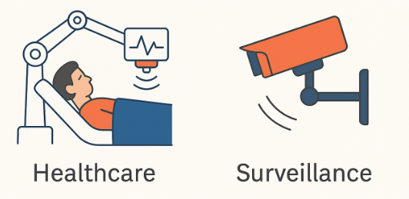
Applications of AI in Computer Vision
Applications of AI in Computer Vision
Focus: Healthcare and Surveillance
AI + CV is revolutionizing industries where visual data is critical. Let’s explore two impactful domains.

Slide 10
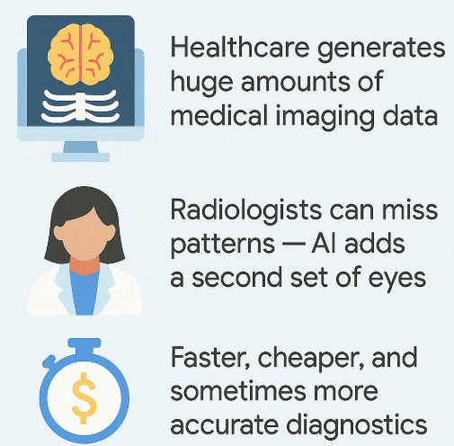
Key Use Cases in Healthcare
AI in Healthcare – Why It Matters
Healthcare generates huge amounts of medical imaging data.
Radiologists can miss patterns — AI adds a second set of eyes.
Faster, cheaper, and

Slide 11
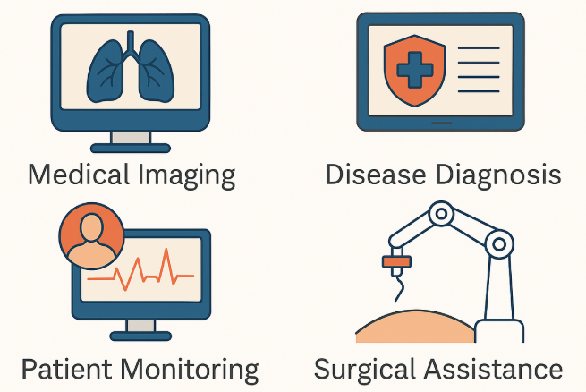
Key Use Cases in Healthcare
Key Use Cases in Healthcare
Brain Tumour Detection (MRI scans)
Lung Disease Diagnosis (X-rays, CT scans for COVID, pneumonia)
Bone Fracture Detection
Histopathology Slide Analysis (cancer cell recognition)

Slide 12
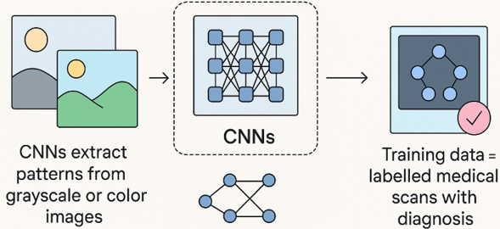
Model Behind the Scene
Models Behind the Scene
CNNs extract patterns from grayscale or coloured images.
Transfer Learning often used with pre-trained models (e.g., ResNet, VGG).
Training data = labeled medical scans with diagnosis.

Slide 13
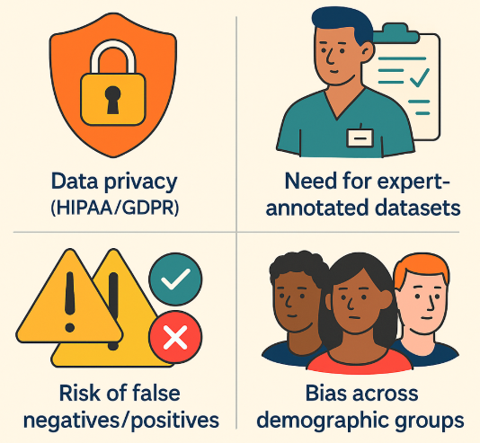
Challenges in Healthcare CV
Challenges in Healthcare CV
Data privacy (HIPAA/GDPR)
Need for expert-annotated datasets
Risk of false negatives/positives
Bias across demographic groups

Slide 14
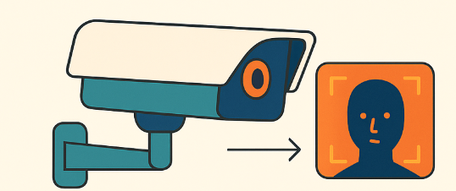
AI in Surveillance
AI in Surveillance – Growing Demand
Surveillance systems today go beyond recording:
They detect, track, and analyze behavior in real time.
AI enables proactive response to events

Slide 15
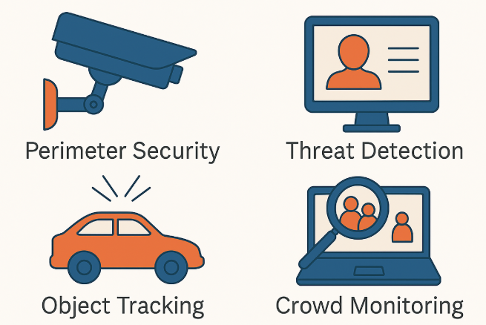
Key Use Cases in Surveillance
Key Use Cases in Surveillance
Face Detection & Recognition
Person Tracking Across Cameras
Anomaly Detection (e.g., violence, unattended bags)
Intrusion Detection in Restricted Areas

Slide 16
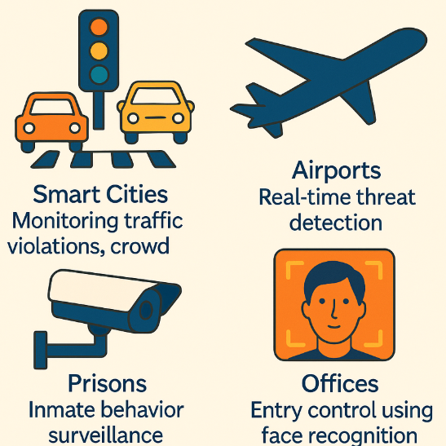
Real-World Examples
Real-World Examples
Smart Cities: Monitoring traffic violations, crowd analysis
Airports: Real-time threat detection
Prisons: Inmate behavior surveillance
Offices: Entry control using face recognition

Slide 17
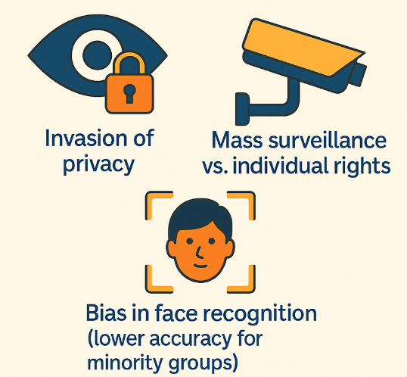
Ethical Concerns in Surveillance
Ethical Concerns in Surveillance
Bias in face recognition (lower accuracy for minority groups)
Invasion of privacy
Mass surveillance vs. individual rights

Slide 18
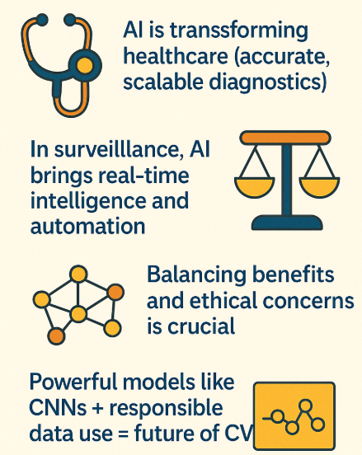
To summarize ………..
AI is transforming healthcare (accurate, scalable diagnostics)
In surveillance, AI brings real-time intelligence and automation
Balancing benefits and ethical concerns is crucial
Powerful models like CNNs + responsible data use = future of CV

Slide 19
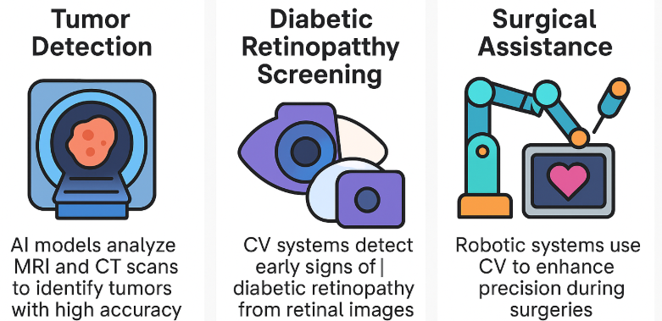
Real Applications of CV
Healthcare
Tumour Detection: AI models analyze MRI and CT scans to identify tumours with high accuracy.
Surgical Assistance: Robotic systems use CV to enhance precision during surgeries.
Diabetic Retinopathy Screening: CV systems detect early signs of diabetic retinopathy from retinal images.

Slide 20
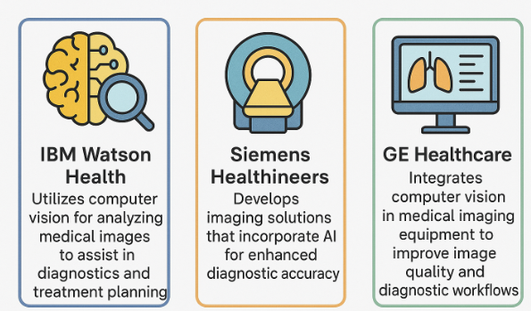
Real Applications of CV
Healthcare
IBM Watson Health: Utilizes computer vision for analyzing medical images to assist in diagnostics and treatment planning.
Siemens Healthineers: Develops imaging solutions that incorporate AI for enhanced diagnostic accuracy.
GE Healthcare: Integrates computer vision in medical imaging equipment to improve image quality and diagnostic workflows.

Slide 21
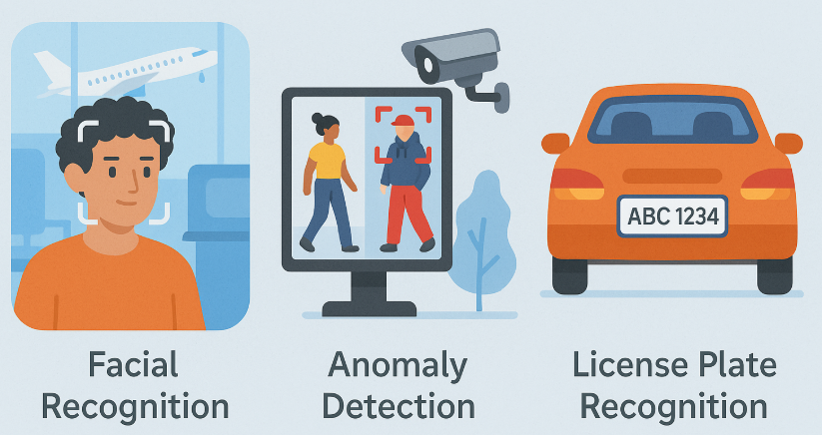
Real Applications of CV
Surveillance & Security
Facial Recognition: Used in airports and public spaces for identity verification.
Anomaly Detection: CV systems monitor CCTV feeds to detect unusual behaviors or incidents.
License Plate Recognition: Automated systems read vehicle plates for traffic management and law enforcement.

Slide 22
Real Applications of CV
Surveillance & Security
Hikvision: Offers video surveillance products with integrated computer vision for facial recognition and behavior analysis.
Axis Communications: Provides network cameras and video analytics solutions utilizing computer vision for security applications.
Avigilon (a Motorola Solutions company): Develops advanced video analytics and surveillance systems powered by AI and computer vision.

Slide 23
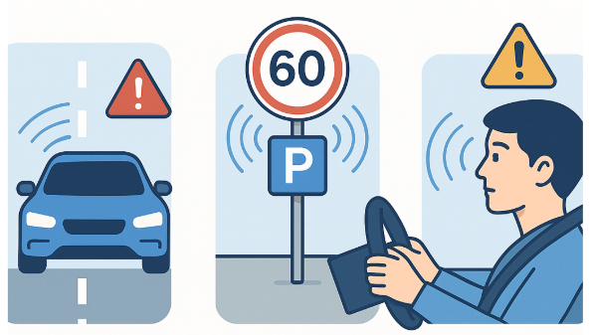
Real Applications of CV
Autonomous Vehicles
Lane & Obstacle Detection: CV enables vehicles to detect lanes and obstacles in real-time.
Traffic Sign Recognition: Systems identify and interpret traffic signs to assist drivers.
Driver Monitoring: CV monitors driver attentiveness and alerts in case of drowsiness or distraction.

Slide 24
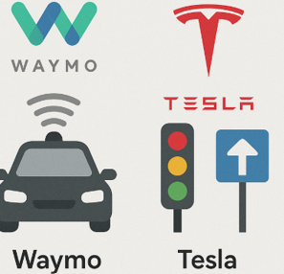
Real Applications of CV
Autonomous Vehicles
Tesla: Employs computer vision for its Autopilot and Full Self-Driving (FSD) features, enabling real-time environment perception.
Waymo (Alphabet Inc.): Utilizes computer vision in its autonomous vehicles for object detection and navigation.
Cruise (General Motors): Develops self-driving technology with computer vision systems for urban transportation.

Slide 25
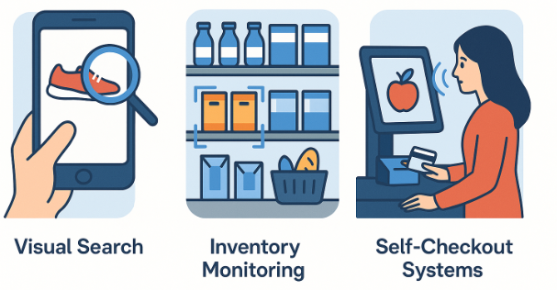
Real Applications of CV
Retail & E-Commerce
Visual Search: Customers can search for products using images.
Inventory Monitoring: CV tracks stock levels and product placement on shelves.
Self-Checkout Systems: Automated checkout processes using CV to recognize products.

Slide 26
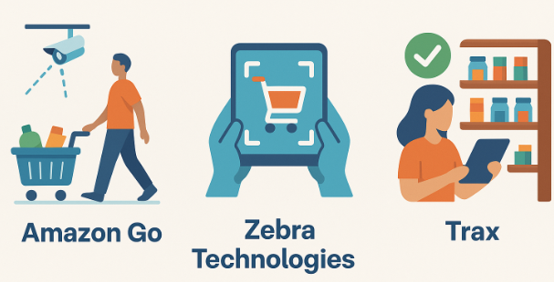
Real Applications of CV
Retail & E-Commerce
Amazon Go: Implements computer vision to enable cashier-less shopping experiences in physical stores.
Zebra Technologies: Provides retail solutions that use computer vision for inventory management and customer analytics.
Trax: Offers computer vision-based retail analytics to monitor shelf compliance and product placement

Slide 27
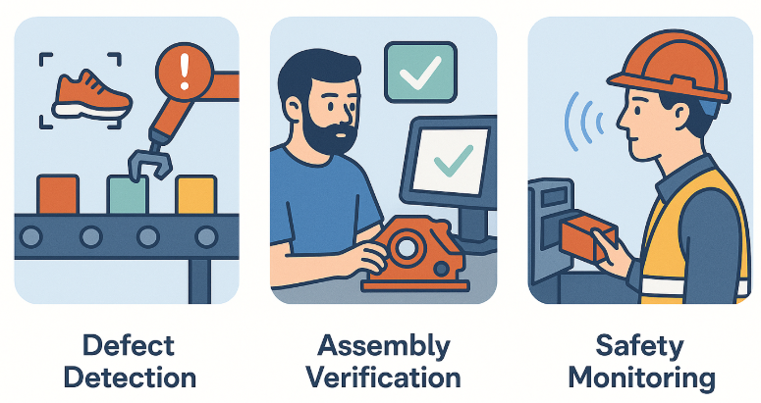
Real Applications of CV
Manufacturing & Industry 4.0
Defect Detection: CV inspects products on assembly lines for defects.
Assembly Verification: Ensures components are correctly assembled.
Safety Monitoring: Detects safety gear compliance and hazardous situations.

Slide 28
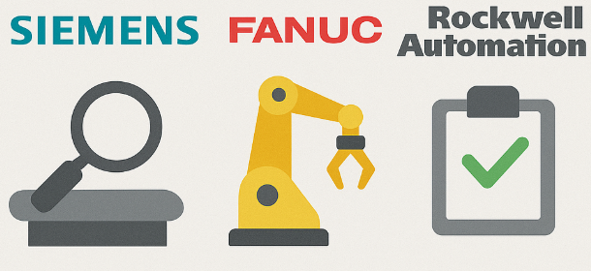
Real Applications of CV
Manufacturing & Industry 4.0
Siemens: Integrates computer vision in manufacturing processes for quality control and predictive maintenance.
Fanuc: Utilizes computer vision in robotic systems for assembly line automation and inspection tasks.
Rockwell Automation: Develops industrial automation solutions incorporating computer vision for process optimization.

Slide 29
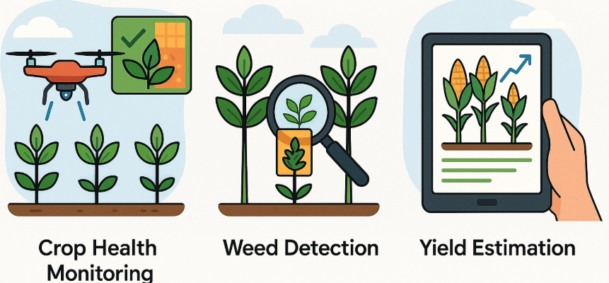
Real Applications of CV
Agriculture
Crop Health Monitoring: Drones equipped with CV assess crop conditions.
Weed Detection: Identifies and locates weeds for targeted removal.
Yield Estimation: Analyzes plant growth to predict harvest yields.

Slide 30
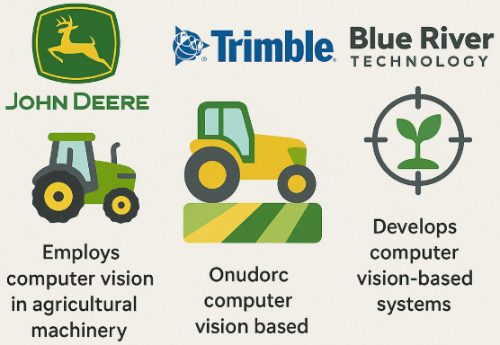
Real Applications of CV
Agriculture
John Deere: Employs computer vision in agricultural machinery for precision farming and crop monitoring.
Trimble: Offers agriculture solutions that use computer vision for field mapping and equipment guidance.
Blue River Technology (a John Deere company): Develops computer vision-based systems for weed detection and crop analysis.

Slide 31
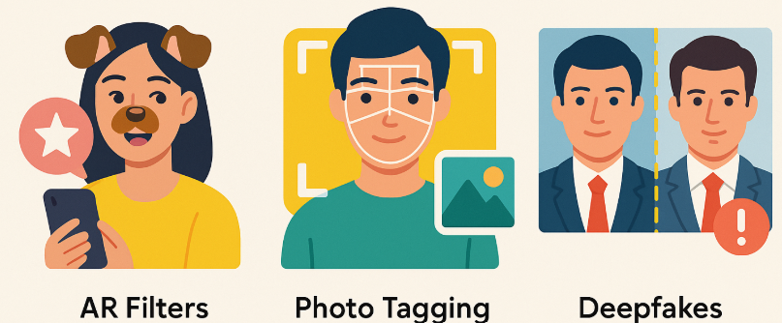
Real Applications of CV
Social Media & Entertainment
AR Filters: Platforms like Snapchat and Instagram use CV for real-time face filters.
Photo Tagging: Automatic tagging of people in photos using facial recognition.
Deepfakes: Generates realistic synthetic media, raising both creative and ethical considerations.

Slide 32

Real Applications of CV
Social Media & Entertainment
Snap Inc. (Snapchat): Uses computer vision for augmented reality filters and facial recognition features.
Facebook (Meta Platforms): Implements computer vision for image tagging, content moderation, and AR experiences.
TikTok: Utilizes computer vision for video effects, content recommendation, and user engagement analysis.

Slide 33
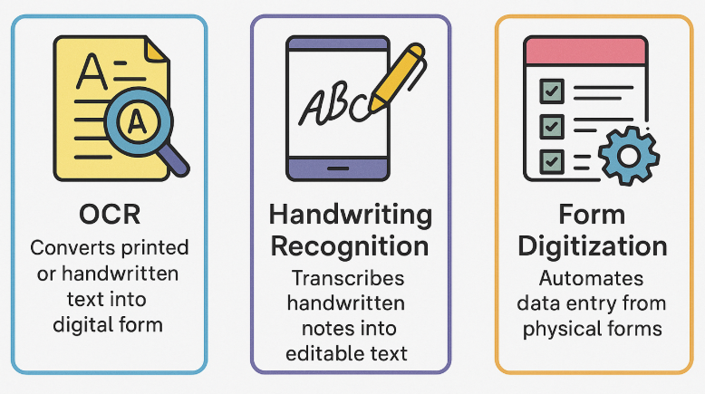
Real Applications of CV
Document & Text Processing
OCR (Optical Character Recognition): Converts printed or handwritten text into digital form.
Handwriting Recognition: Transcribes handwritten notes into editable text.
Form Digitization: Automates data entry from physical forms.

Slide 34

Real Applications of CV
Document & Text Processing
Adobe Systems: Incorporates computer vision in its software for image recognition and document scanning.
ABBYY: Provides OCR and document processing solutions powered by computer vision technologies.
Kofax: Offers intelligent automation software that uses computer vision for data extraction and document classification.

Slide 35
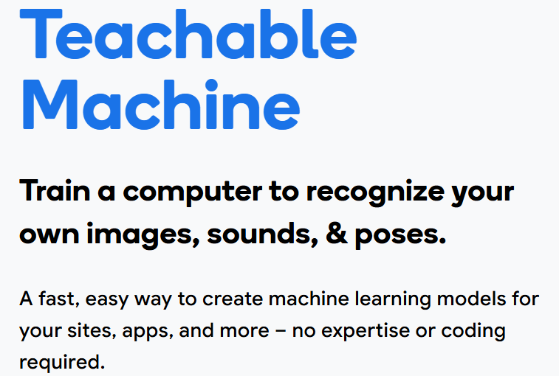
Teachable Machine

Slide 36
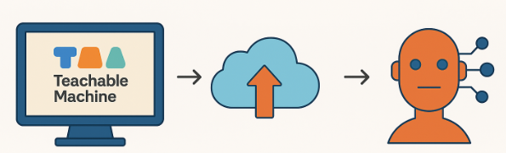
Introduction to Teachable Machine
Introduction to Teachable Machine
What is it?
A web-based tool by Google
Teachable Machine is a web-based tool that makes creating machine learning models fast, easy, and accessible to everyone.
Enables anyone to create machine learning models with no coding
Supports:
Image classification
Sound classification
Pose detection

Slide 37
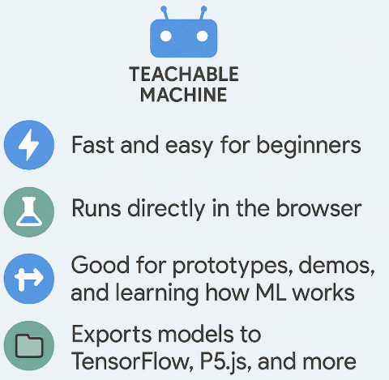
Why Use Teachable Machine

Slide 38
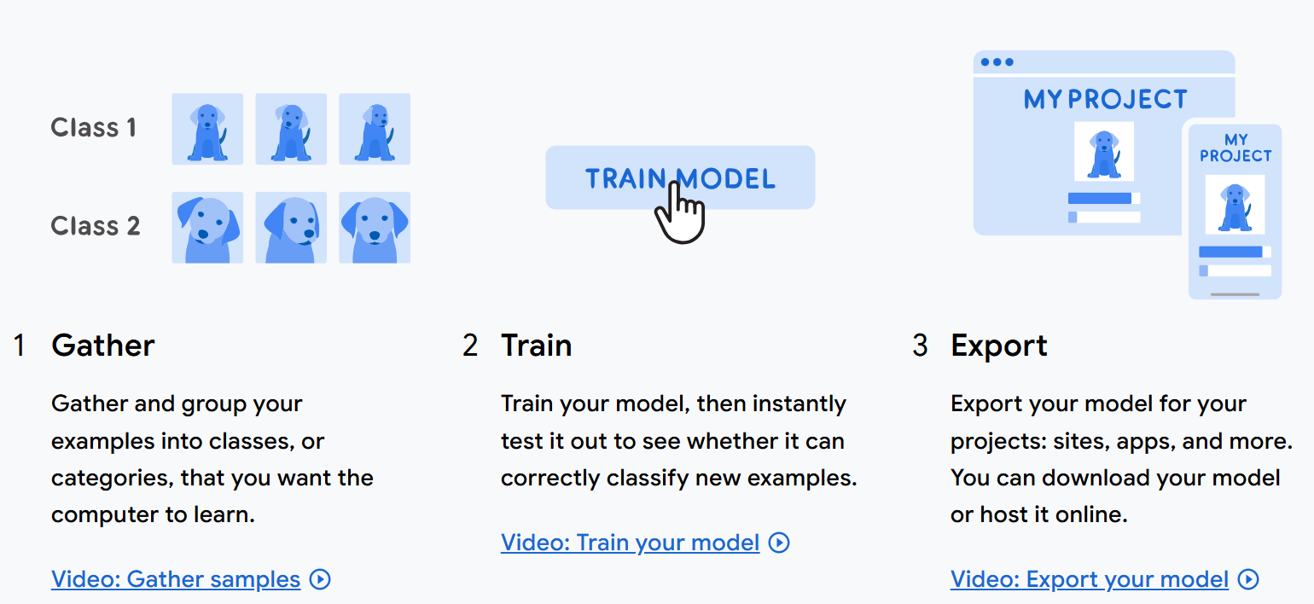
Teachable Machine: How do I use it

Slide 39
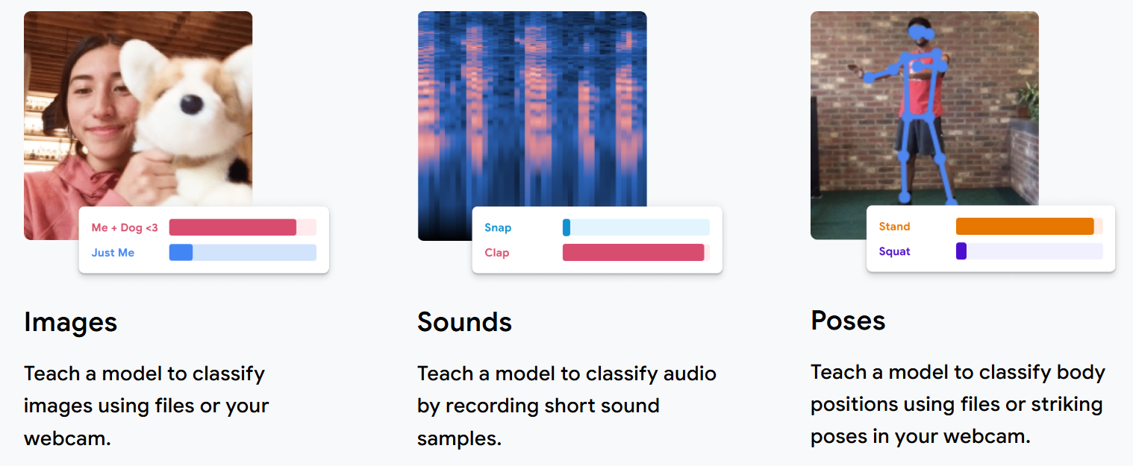
Teachable Machine: What can I use to Teach It

Slide 40
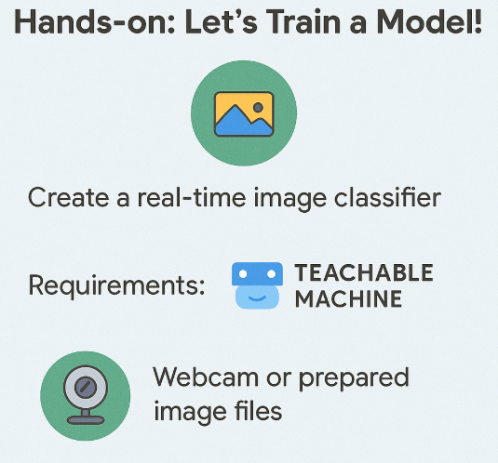
Hands-On

Slide 41
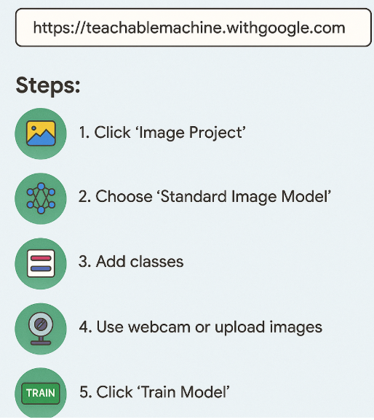
Teachable Machine: Quick Setup

Slide 42
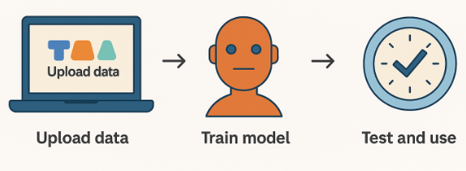
Teachable Machines: Typical Workflow
Typical Workflow
Select project type (image/audio/pose)
Create classes (e.g., Happy Face, Sad Face)
Train with examples (via webcam or upload)
Test the model
Export or use directly in browser
Key Considerations Before Training
Use well-lit environment
Keep background clean
Capture multiple angles and positions for each class
Minimum: ~30–50 samples/class for decent accuracy

Slide 43
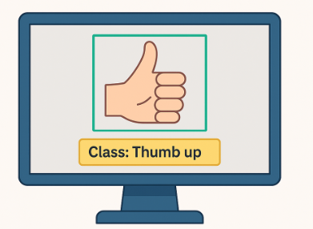
Demo
Demo Preview – What We’ll Build: Real-time Image Classifier
Use webcam to collect image samples
Train a model to distinguish between:
Open palm vs. closed fist
Mask vs. No Mask
Healthy leaf vs. Diseased leaf (for agriculture/healthcare)

Slide 44
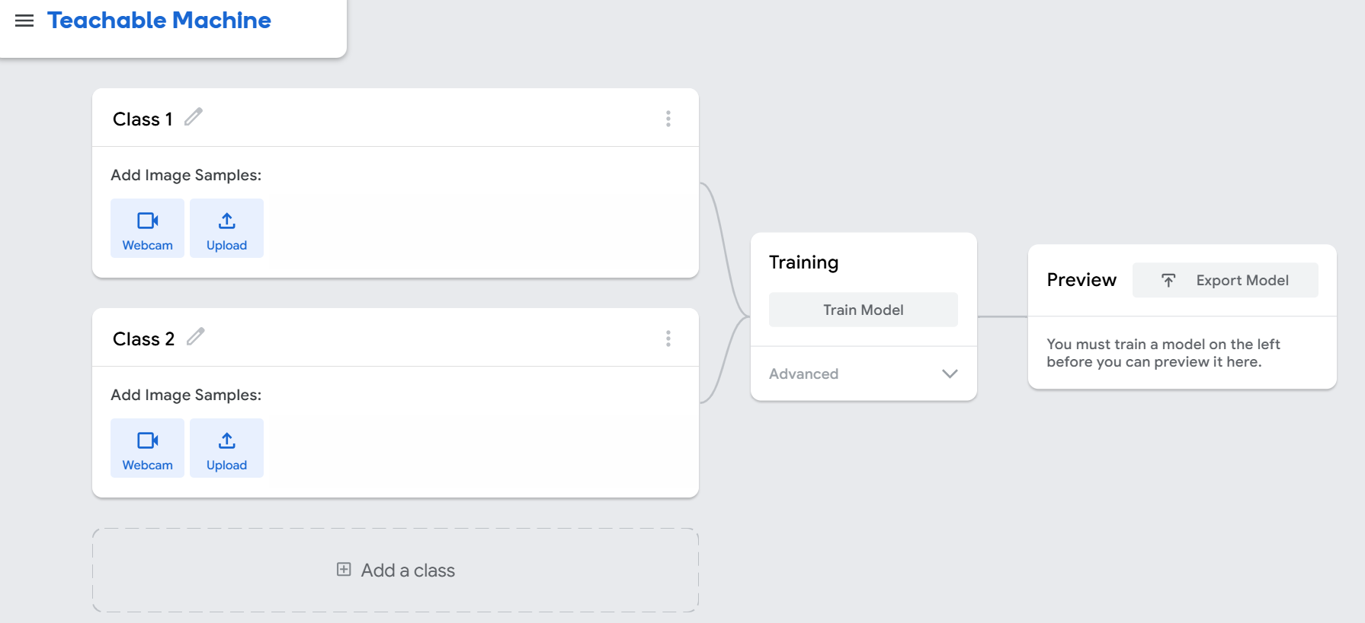
Demo

Slide 45
Strengths & Limitations
Strengths of AI in Computer Vision
Learns from data, no manual rules
Can outperform humans in certain tasks
Scales easily – one model can be used everywhere
Quick deployment with tools like Teachable Machine
Limitations & Cautions
Needs a lot of clean, labeled data
May fail in real-world conditions (lighting, noise, etc.)
Can be biased if training data is biased
Lack of explainability in deep models

Slide 46
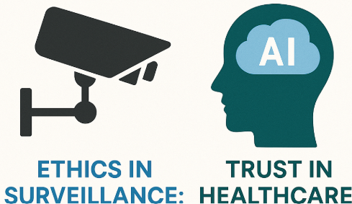
Real-World Considerations
Real-World Considerations
Ethics in Surveillance:
Are we being watched too much?
Is consent involved?
Trust in Healthcare:
Should doctors rely on AI for diagnosis?
Can we explain why AI made a specific prediction?

Slide 47
THANK YOU

